Slide 1
Main causes of the renaissance
Background

Slide 2
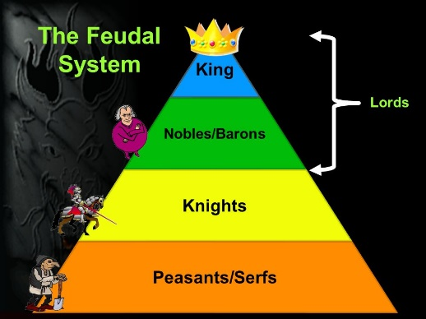
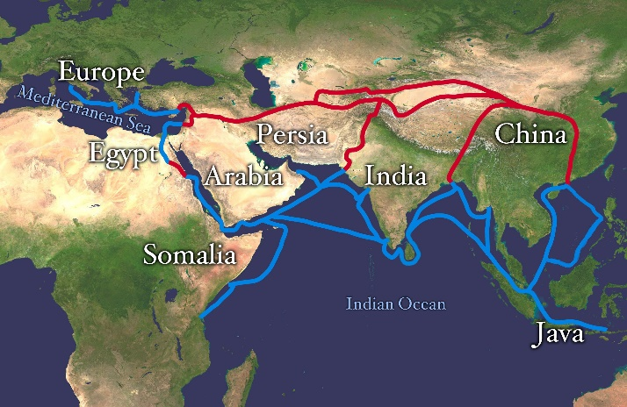
1. Increased interaction
A. Europe was in the Middle Ages (Medieval Period)
- feudalism
- devout religious faith
B. Silk Road
- vast trade networks allowed different cultures to interact
- exchanged goods, but also people, beliefs, ideas, & values
- 120 BCE to 1450 CE
- stretched from Japan to Italy

Slide 3
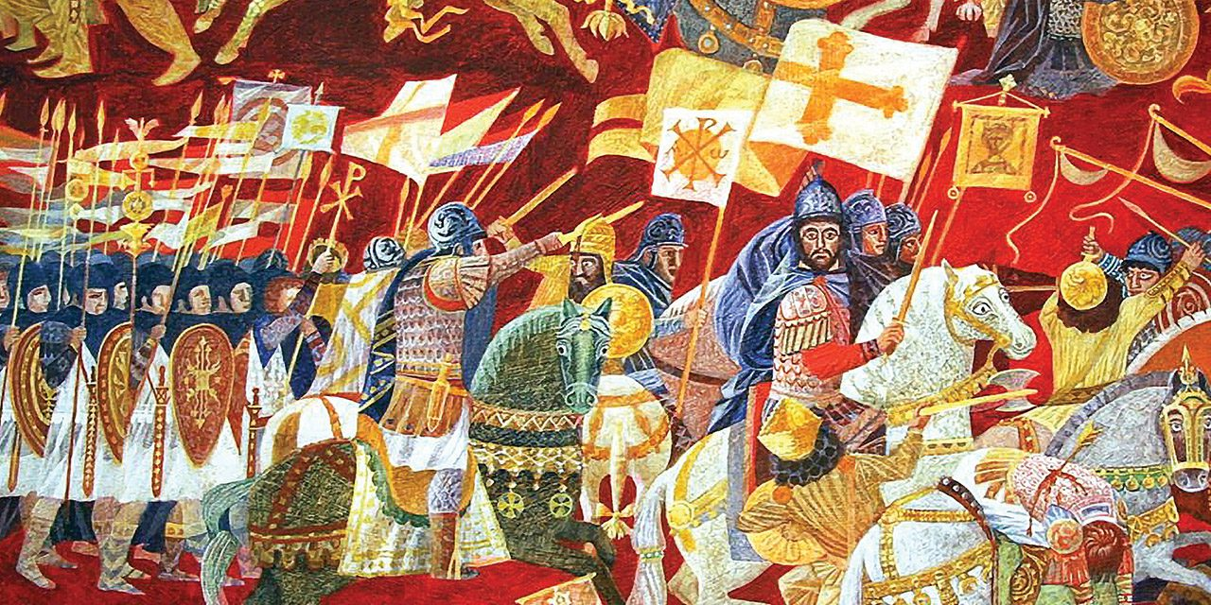
2. crusades
A. Religious wars carried out by Christian crusaders
- European knights tried to take control of the Holy Land (Jerusalem) from the Muslim people
- 9 main crusades and many smaller ones over 2 centuries
- caused a major clash between Christianity, Judaism, and Islam

Slide 4
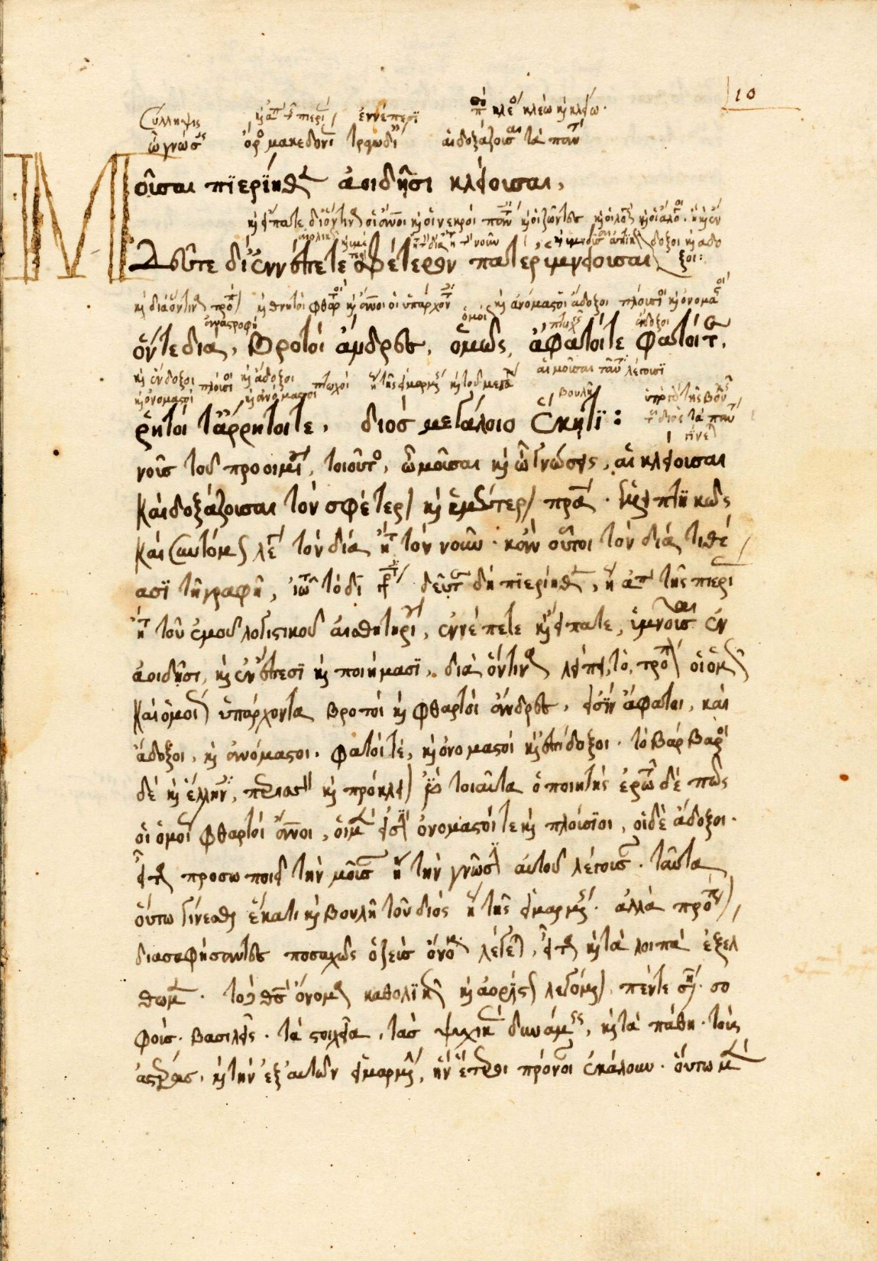
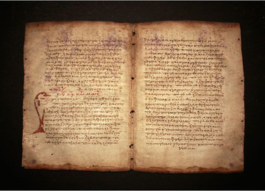
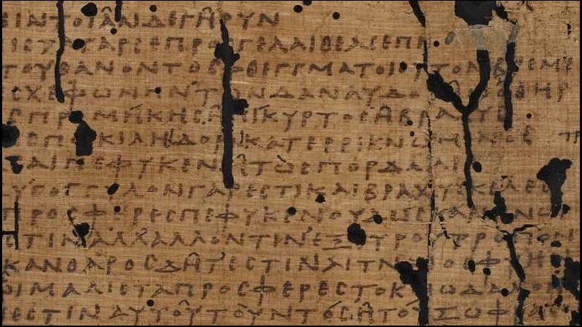
3. Rediscovery of ancient texts
A. Rediscovered ideas and texts from the ancient Greeks and Romans
B. The material was being kept in libraries in the Middle East and Asia

Slide 5
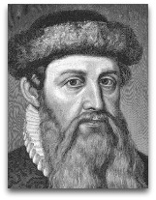
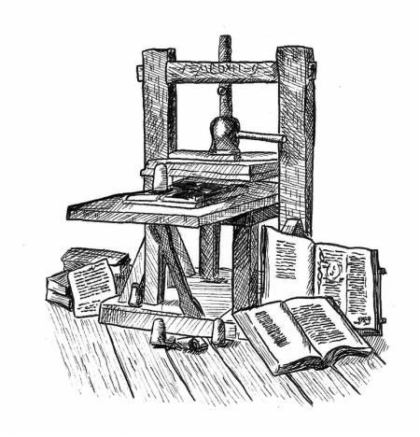
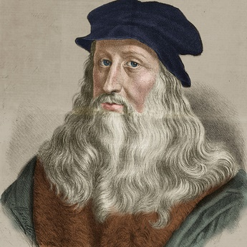
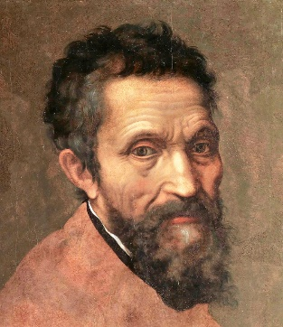
4. innovations
A. Publishing
- Johannes Gutenberg developed the printing press in the mid 1400s
- information was able to be spread much quicker
- more people could now afford books, so literacy also increased
B. Art
- during the Middle Ages, art focused on religious themes
- during the Renaissance, art was inspired by the realities of everyday life and people
- Leonardo da Vinci and Michelangelo created skills and techniques in paintings and sculptures

Slide 6
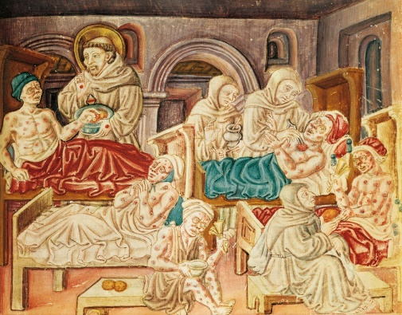
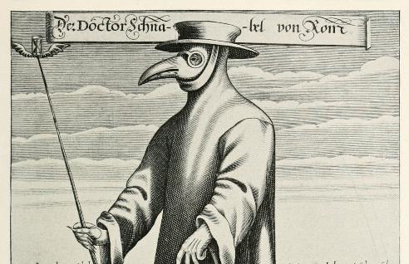
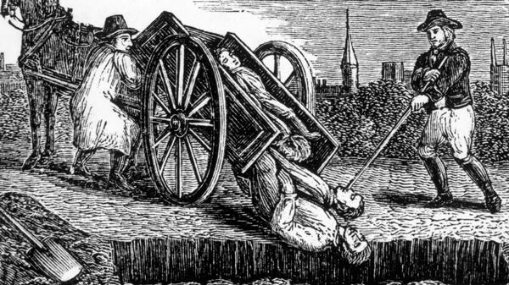
5. Black death
A. The Bubonic Plague caused by a bacteria spread among wild rodents, human fleas, and lice
- living quarters and lack of personal hygiene helped it spread
B. During the 14th century, it ravaged the populations throughout Europe and Asia
- followed the trade routes
- 75-200 million people in Eurasia (30%-60%) died
C. Most believe the plague ended by implementing quarantines among the sick and the healthy

